Slide 1
Splash Screen

Slide 2
Lesson Menu
Five-Minute Check (over Lesson 6–3)
Then/Now
New Vocabulary
Example 1: Identify Proportional Relationships
Example 2: Identify Proportional Relationships
Example 3: Real-World Example: Describe Proportional Relationships

Slide 3
5-Minute Check 1
Complete. Round to the nearest hundredth. 16 oz ≈ ___ g
A. 500 g
B. 453.60 g
C. 45.6 g
D. 32 g

Slide 4
5-Minute Check 2
Complete. Round to the nearest hundredth. 4 c ≈ ___ mL
A. 946.35 mL
B. 846.35 mL
C. 400 mL
D. 6.84 mL

Slide 5
5-Minute Check 3
Complete. Round to the nearest hundredth. 11 km ≈ ___ mi
A. 10 mi
B. 9.4 mi
C. 7.48 mi
D. 6.84 mi

Slide 6
5-Minute Check 4
Complete. Round to the nearest hundredth. 245 g ≈ ___ lb
A. 0.45 lb
B. 0.54 lb
C. 4.5 lb
D. 5.4 lb

Slide 7
5-Minute Check 5
A space shuttle is traveling at 17,500 miles per hour. How many kilometers per second is the space shuttle traveling?
A. about 10 km/s
B. about 9 km/s
C. about 8 km/s
D. about 7 km/s

Slide 8
5-Minute Check 6
Jessica is 64 inches tall. What is her height to the nearest centimeter?
A. about 120 cm
B. about 180 cm
C. about 163 cm
D. about 220.5 cm

Slide 9
Then/Now
You have already used unit rates to convert measurements. (Lesson 6–3)
Identify proportional and nonproportional relationships in tables and graphs.
Describe a proportional relationship using an equation.

Slide 10
Vocabulary
proportional
nonproportional
constant of proportionality

Slide 11
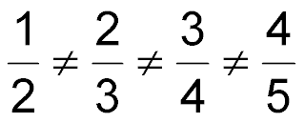
Example 1
Identify Proportional Relationships
Determine whether the cost of baseballs is proportional to the number of baseballs. Explain your reasoning.
Answer: No; the rates are not equal.

Slide 12
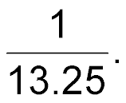
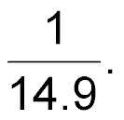
Example 1
Determine whether the set of numbers in the table are proportional. Explain your reasoning.
A. Yes, all the rates are equal to
B. Yes, all the rates are equal to
C. Yes, all the rates are equal to
D. No, the rates are not equal.

Slide 13
Example 2
Identify Proportional Relationships
Determine whether the number of inches is proportional to the number of seconds. Explain your reasoning.
Write the rate of time to distance for each second in simplest form.
Answer: Yes; all the rates are equal.

Slide 14
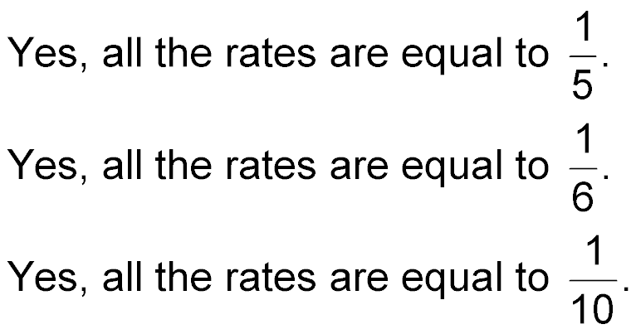
Example 2
Determine whether the number of meters is proportional to the number of seconds. Explain your reasoning.
A.
B.
C.
D. No, the rates are not equal.

Slide 15
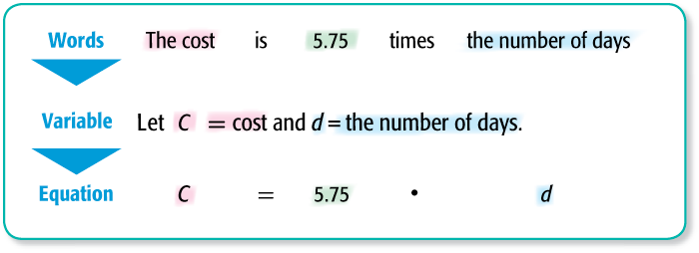
Example 3
Describe Proportional Relationships
WORK Nina charges $34.50 for 6 days of pet sitting. Write an equation relating the cost of pet sitting to the number of days. What would be the cost of pet sitting for 4 days?
Find the constant of proportionality.
34.50 ÷ 6 = 5.75
.

Slide 16
Example 3
Describe Proportional Relationships
C = 5.75d Write the equation.
= 5.75 ● 4 Replace d with 4.
= 23 Multiply.
Answer: The cost would be $23.

Slide 17
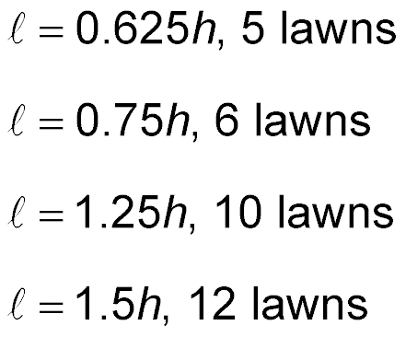
Example 3
Howard can cut 15 lawns in 12 hours. Which is the correct equation and answer for finding how many lawns he could mow in 8 hours?
A.
B.
C.
D.

Slide 18
End of the Lesson

